Slide 1
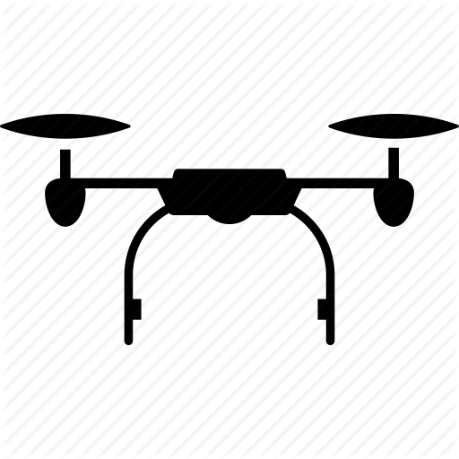

Seismic Drone Data Acquisition System
Seismic Drone(Geophone Sensors +Seismic Recorder + Data Storage +Battery)
Source (Vibrating truck with motor and piston)
1.
2.
3.
23.
24.
Vibrating Plate
Vibrational
Waves

